Slide 1


Data Mining Project
Classification of Smokers and Drinkers
Ronit Kumar(48)
Paras Kumar(37)

Slide 2


Content
1.Problem Statement
2. About Dataset
3. Data Preprocessing
4. Data Visualization
5. Models
6. Conclusion
7.References

Slide 3


Problem Statement
Smoking and drinking are detrimental to health due to their severe adverse effects.
Some people smoke or drink excessively to relieve stress or cope with problems. Studies have shown that social norms play a part in shaping behaviour. Often, people smoke or drink among friends who do so, to be socially accepted. Also People hide this information from doctors, parents or life insurers because of fear of being looked down upon.
Our Model, on the basis of vitals of the body or on the basis of body signals, will classify whether a person is a smoker or drinker.

Slide 4

About Dataset
The dataset is collected from the National Health Insurance Service in Korea. All personal information and sensitive data were excluded. Link for the dataset :
https://www.kaggle.com/datasets/sooyoungher/smoking-drinking-dataset/code
Our Dataset has 24 attribute and about 1 million instances.

Slide 5

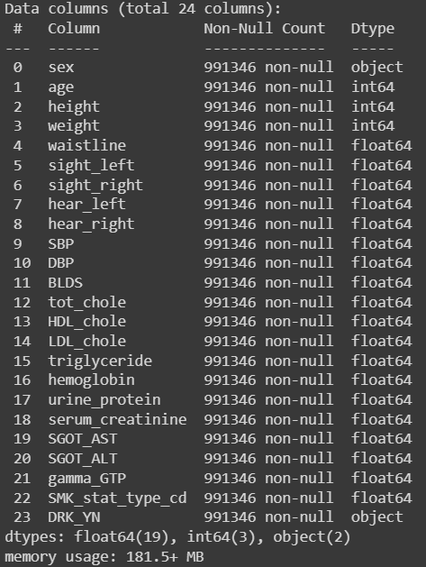
dataset.info() function is used to show all the attributes, its datatype and count of non null instances.
No attribute has null values.

Slide 6
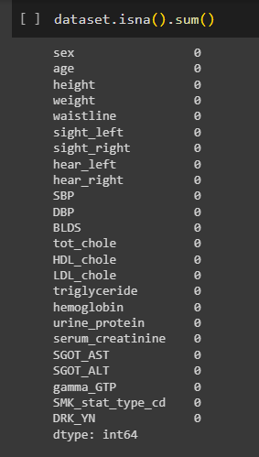
Data Preprocessing
1) Dealing with null values
Luckily, Our dataset have no Null Values.

Slide 7
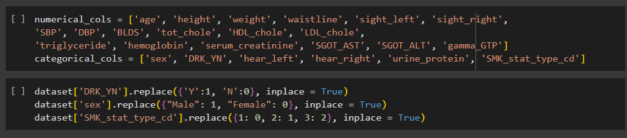
2) Data Transformation
There are 6 categorical and 18 numerical variables in our dataset. We'll transform the categorial values into numerical values.
For our Classification Problem, We'll find out whether a person is a drinker or not. After transformation this is given by the attribute DRK_YN where value 1 is for Yes person is a Drinker and 0 is for Not a Drinker.

Slide 8



There are some duplicate values, but because the dataset have larger number of rows, we will simply drop the duplicate values.

Slide 9
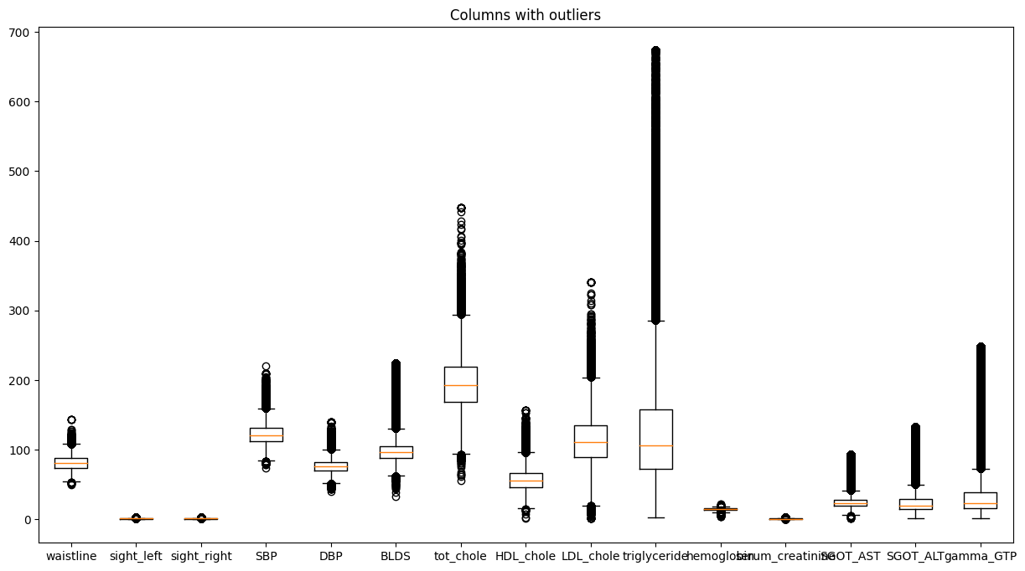

Slide 10
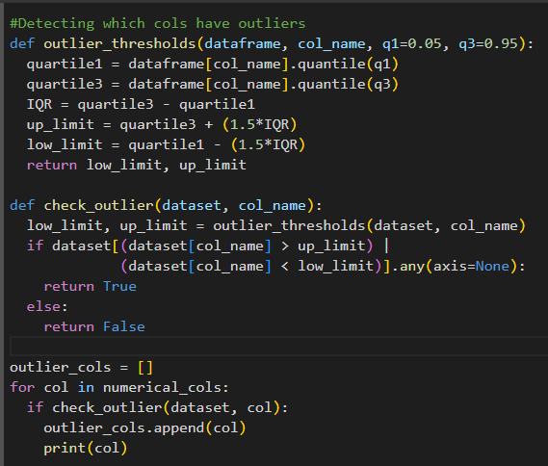
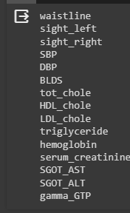
Fixing Outliers - The code below finds all the columns that have outliers in them. IQR method is used to find the outliers.
Ouliers in these columns are removed using winsorization.

Slide 11
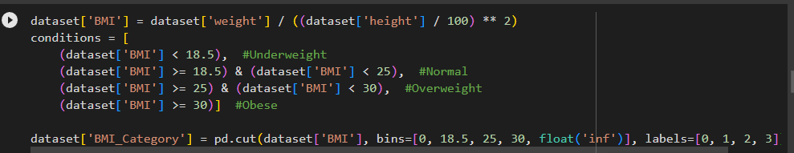
Feature Creation
Since we have Height and Weight in our data, we can create a BMI column and a BMI_Category column.

Slide 12


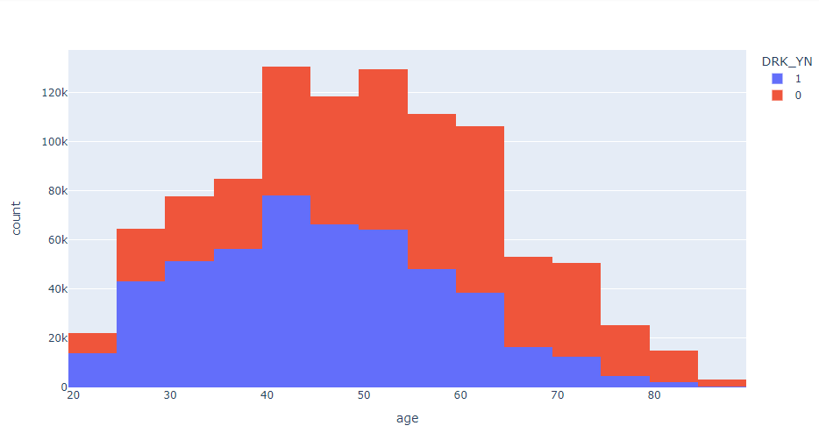
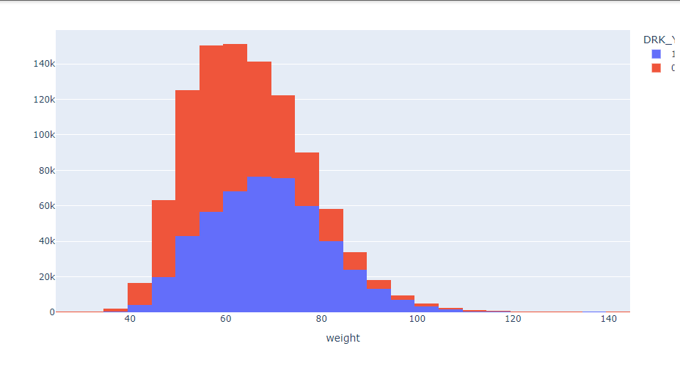
Data Visualization
This histogram shows the distribution of Drinkers w.r.t Age in the dataset
This histogram shows the distribution of Drinkers w.r.t Weight in the dataset
This step is helpful to increase familiarity with the data that we are working on.

Slide 13
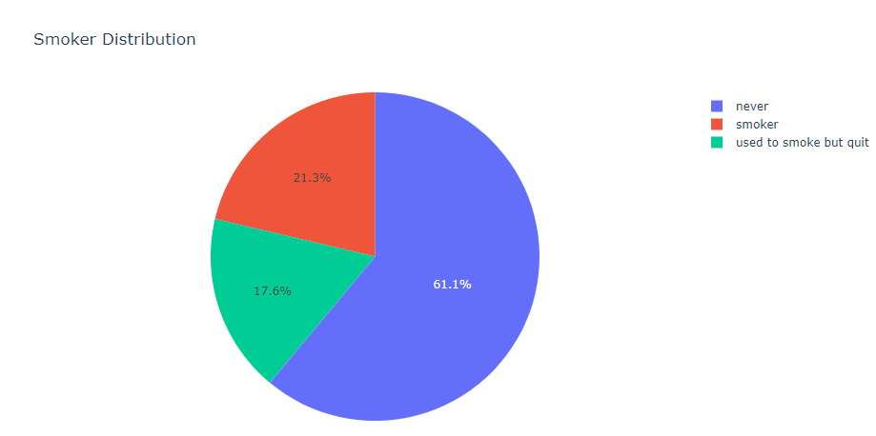
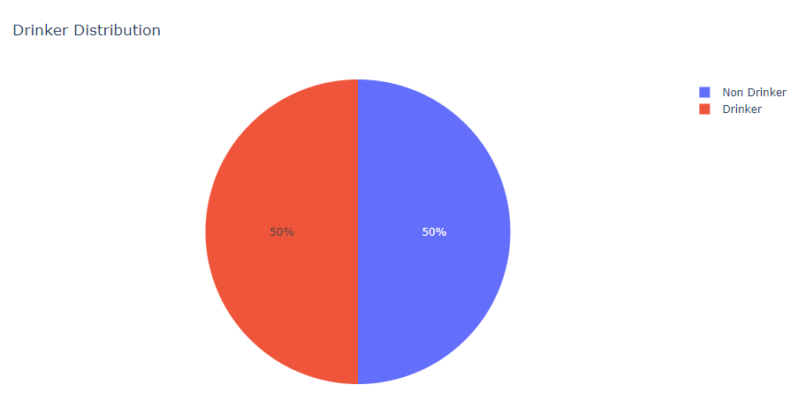
Data Visualization

Slide 14

Models
There are number of models for classification problems but taking reference from research papers we have read, here we will use 3 models and compare their performance metrics to find out the best suited model for our data. We used these models:
•Random Forest
•Logistic Regression
•Decision Tree
Performance metrics that were used : accuracy, confusion matrix , RoC Curve, AUC.
Sklearn python library is used for models, data normalization and splitting of dataset into train and test(80-20 Split).

Slide 15
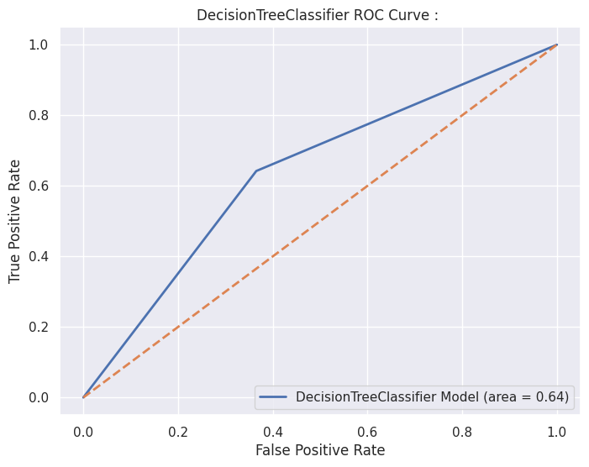
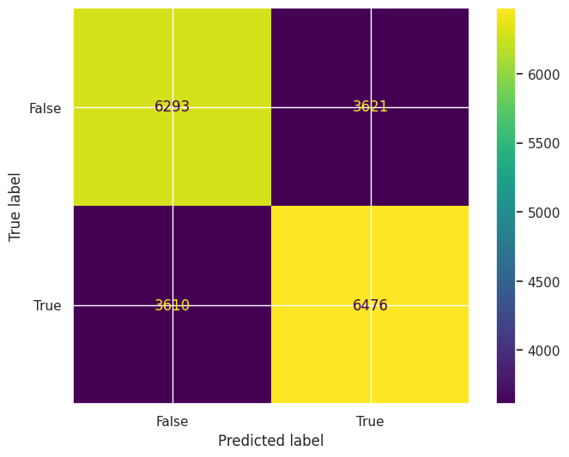
Decision Tree
Decision Tree CLF achieved an accuracy of 63.84% for drinkers classification.
ROC Curve
Confusion Matrix

Slide 16

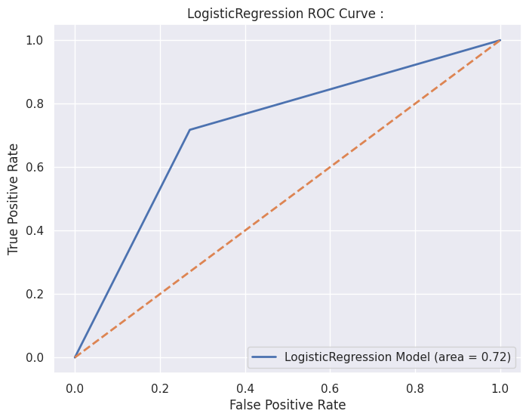
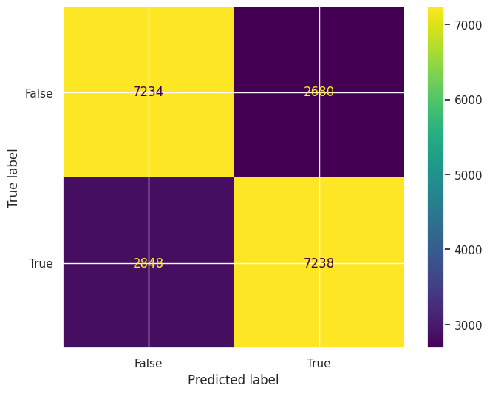
Logistic Regression
Logistic Regression CLF achieved an accuracy of 72.36% for drinkers classification.

Slide 17
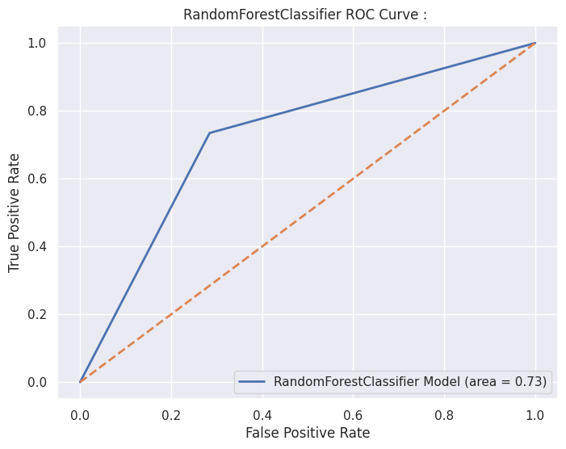

Random Forest
Random Forest CLF achieved an accuracy of 72.51% for drinkers classification.

Slide 18
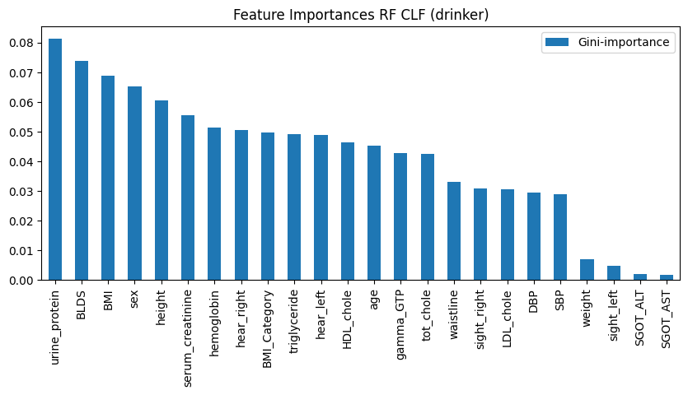
Feature Importance

Slide 19
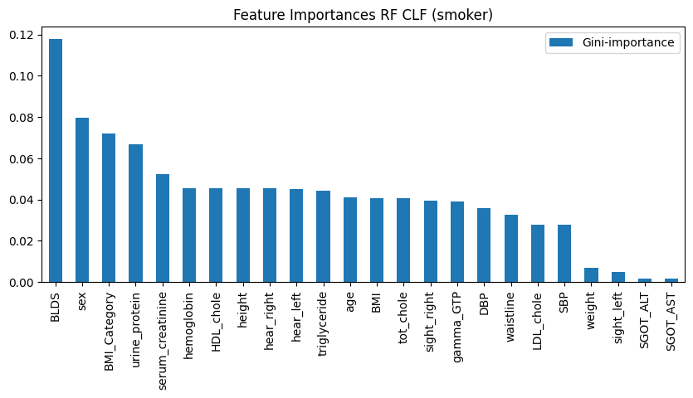
Feature Importance

Slide 20
Conclusion
For drinker classification we found that the Random Forest Classifier worked best for identifying whether a person is a Drinker or a Non Drinker, Logistic Regression Classifier performed almost similar to Random Forest Classifier.
For smoker classification problem, again, Random Forest Classifier worked the best, giving the maximum accuracy and precision.
Random Forest also achieved the highest ROC AUC in both the classification problems.

Slide 21

Lamprou, Sokrates, A study in alcohol: A comparison of data mining methods for identifying binge drinking risk factors in university students.https://www.divaportal.org/smash/get/diva2:1537520/FULLTEXT01.pdf
Radhika P R, Rakhi A S Nair, Veena G, A Comparative Study of Lungs Cancer Detection using Machine Learning Algorithms.https://ieeexplore.ieee.org/document/8869001
https://scikitlearn.org/stable/modules/generated/sklearn.tree.DecisionTreeClassifier.html#sklearn.tree.DecisionTreeClassifier
https://scikit-learn.org/stable/modules/linear_model.html#logistic-regression
https://scikit-learn.org/stable/modules/ensemble.html#random-forests

